Slide 2
Reason for containers
Use case
As a developer, I want a Node server so that I can host my NodeJS application
Options
Bare Metal – Costly (machine underutilised)
VM – Administrative effort + cost (machine underutilised)
Container – Stripped down version of an OS with Node + app installed
Can have many containers running on the same machine (fully utilised machine)
Containers are portable
Effective isolation and resource sharing

Slide 3
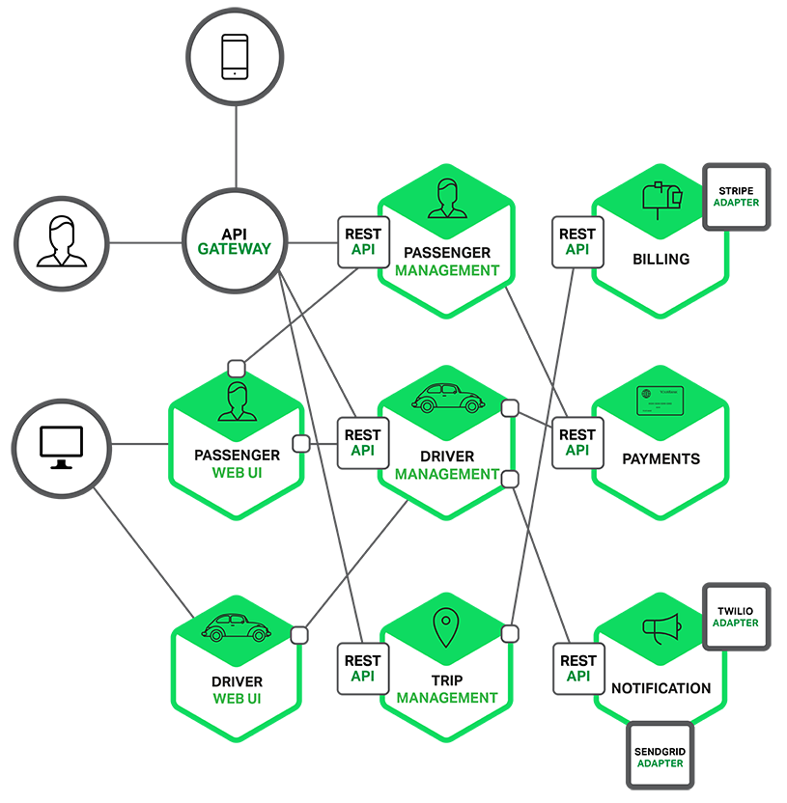
Taxi Service Application Using Micro Services

Slide 4
Reason For Micro Services
Application is broken down into functions, each function representing a micro service
Each micro service will be small and easy to manage
Each micro service can be developed and deployed independently
Easier to manage scalability, can have many instances for a given function e.g. login

Slide 5
Node Calculator with micro services
Add
Web UI
Subtract

